Slide 1
RTOW Spring 2024 Business Meeting

Slide 2
Agenda
Welcome
Board Member Reports
Education Program Reports
By-Law Changes
Open Board Positions/Nominations
Survey Results

Slide 3
Northeast Region
RTOW Report – NE Region
SSM Health-Fond du lac: Will be going live with Eclipse treatment planning system in May and replacing their Trilogy linac with a TrueBeam + Vision RT system this Fall
Aurora BayCare: Have been tattoo-less for about 2.5 years and love it. Have the All In On-board System, which allows them to be vac bag-free
Aurora-Grafton: installed a 6 DOF couch in February & have been tattoo-less for about 6 months
Froedtert: Holy Family Manitowoc has an OPT RTT position open now that will turn into a full-time RTT position ( there is an RTT that will be retiring in December of 24), and they want that person hired, trained, and working between now and then – they would look at a new graduate. Sarah Beisbier is the hiring manager for this one.
Morgan Crowie
Bellin College

Slide 4
Northwest Region
Prevea Cancer Center at HSHS Sacred Heart Hospital: They are currently closing the hospital, so there will no longer be any cancer treatment services at this center.
Aspirus Cancer Care System (which includes James Beck Rhinelander, Stevens Point, Wausau, Wisconsin Rapids, and Volm Cancer Center) They are happy to announce after several years that they are bringing back their Spring Oncology Forum. - This year's event will take place at the Hilton Garden Inn in Wausau on April 13th. To see more or register for this event, please visit aspirus.org and search for "spring”
Marshfield Medical Center Health System: -
Rice Lake. Currently recruiting for a radiation oncologist.
Eau Claire: There has been an increase in volume for medical and radiation oncology due to HSHS/Prevea Health closures. They are working with regional organizations weekly to assist with patient referrals.
Marshfield: Is currently recruiting for a physicist. This is a center with many special procedures including Gamma knife, prostate seeds, and HDR services.
Stevens Point / River Region: Is continuing to offer many HDR services for the system such as skin, GYN
Weston: Had a new TrueBeam with Identify go live in December of 2023. The previous linac was a 23ex with CBCT (added in 2013), which was originally installed when the facility first opened in 2005-2006.
Minocqua: Currently recruiting for a physicist, posted a full time RTT position
Marshfield Medical Center also mentioned that they will have some radiation therapy job postings in the very near future, so those who are interested should keep an eye on the website for new postings.
Marissa DeCleene
SSM Health Greater
Fond du lac cancer center

Slide 5
Southwest Region
Gundersen Health System Daina Drath
One current PRN RTT opening
Recently instilled SGRT Identify v. 3.0 in both La Crosse and Tomah locations •
Gunderson and Belling merged, rebranding will soon be announced (it's not a new organization, just new names for both)
Mayo Clinic Health System Rachel Rye
No open positions at this time.
Recently upgraded and installed a Siemens Xcite Scanner and Brainlab Dynamic Systems.
UW Health Hospital Stephanie Bailey
Very exciting time - currently building
East Park Medical Center. Opening October 2024!
East Park will be home to two TrueBeams, one Edge, CT sim, MR and HDR.
East Park will eventually be the location of proton therapy.
The East Clinic location will close when East Park opens.
Currently interviewing for a number of positions and will have additional needs in the near future due to expansion.
SSM Health, St. Clare Hospital
April Holler (will be open position with her moving to Turville Bay)
Recently hired a PRN RTT - will start in August after passing her boards.
April Holler is leaving a Clinic Manager and will be the new Manager of Turville Bay - Hiring for Clinic Manager position.
This center continues to be very busy for one linac.
SSM Health St. Mary's Hospital Noelle Ziegelbauer
Fully staffed.
No plans for new equipment at this time.
SSM Health Monroe Clinic-Sue Campbell
UW Health Cancer Center, Johnson, Lauren Hein
SSM Health Turville Bay, April Holler
Mercy Health Hospital, Natalie Amundson
Beloit Memorial Hospital, Nicole Kovarik
Melissa Norin
Froedtert & the Medical College of Wisconsin

Slide 6
Southeast Region
Froedtert South: Pleasant Prairie
3 -1.0 FTE Available
$12,000 sign on bonus
Aurora Sinai Medical Center, Milwaukee
1- 1.0 FTE Available
Columbia St Mary’s Milwaukee Campus
PRN Position
Ascension All Saints
1.0 FTE Cancer Center Manager
RTT or RN credentials required
Froedtert:
Proton Center Opening August 2025, 7 weeks ahead of schedule for construction
0.8 FTE RTT ( would like to hire now before June) at Froedtert Main campus- Milwaukee.
Future positions for the Froedtert Main Campus:
As of July 1 – looking for at least 2 more full time RTT and 2 more dosimetrists as ramp up staffing for the opening of Proton center (will be shifting current/existing staff to the proton center and will be hiring to fill in those previous RTT /DOS roles with new hires - these could be new grads)
Alison behling
Marshfield clinic- Eau claire

Slide 7
Secretary’s Report
Dana Peterson
West Michigan cancer center

Slide 8
Treasurer’s Report
Amy Riemer, Bellin College

Slide 9
Additional Board Members
President: Kim Keding, Varian
President-Elect: Miranda Scheppler, Marshfield Clinic-Marshfield Center
Webmaster: Heather Bowe, UW Health Johnson Creek
ASRT Credit Submitters:
Dani Mann SSM Fond du Lac,
Sarah Seefeld, Ascension Columbia St. Mary
Bylaw Administrator: Kim Keding

Slide 10
UW-LaCrosse
Program Director
Melissa Weege
Student Representative(s)
Kayla Rausch
Sara Lesniewski

Slide 11
Bellin
Program Director
Amy Riemer
Student Representative(s)
Kayla Thorp
Teagan Johnson

Slide 12
By-Law Changes

Slide 13
Policies and Procedures: Section 4: Meeting Planning Item 8: Guidelines on expenditures for Speakers
After the verbiage of:
Meeting planner/organizer should inform RTOW Treasurer of the details of the type of reimbursement need to be submitted on the honorarium reimbursement form along with the outline of speaker’s presentation so to be reimbursed at the time of the meeting.
Add:
RTOW executive board will have the discretion to reduce the amount of honorarium by half in the event the budget is less than $8,000 at the time of the reimbursement request. Communication will be given to the planner/organizer if such direction will occur.

Slide 14
Section 2: Benefits of Membership
After the verbiage of:
All members shall have access to any RTOW meeting or mini-meeting.
Add:
Add 2.2 Any membership paid by the Spring conference will be eligible to receive the Fall Virtual session(s) for free.

Slide 15
Section 5: Financial Aspects
Current dues rates are as follows:
$30 for Active members
$15 for Student
$20 for Retired
50% Discount Graduate Bridge
Change:
$40 for Active members
$15 for Student
$20 for Retired
50% Discount Graduate Bridge

Slide 16
Open Positions/Nominations
Terms will be voted in the fall of 2024 and commence Fall of 2026
Secretary—Dana Peterson willing to take another term
Southwest—Kayla Rausch Nominated
Southeast—Melissa Norin Nominated
~~~~~~~~~~~~~~~~~~~~~~~~~~~~~~~~~~~~~~~~~~
By-law Administrator—not a voted-in position, but appointed by the President/Board… if anyone is interested, please let us know

Slide 17
Future Meetings
Fall 2024-
Can be virtual or in-person
Looking for Hosts for in-person option
Looking for speakers for either in-person or virtual
Spring 2025- In Person
Host needed
Speakers needed

Slide 18
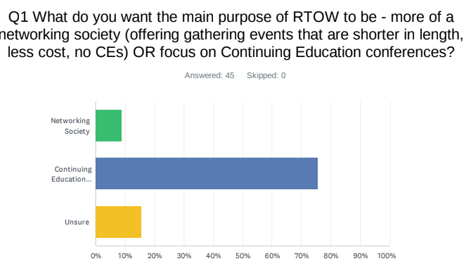
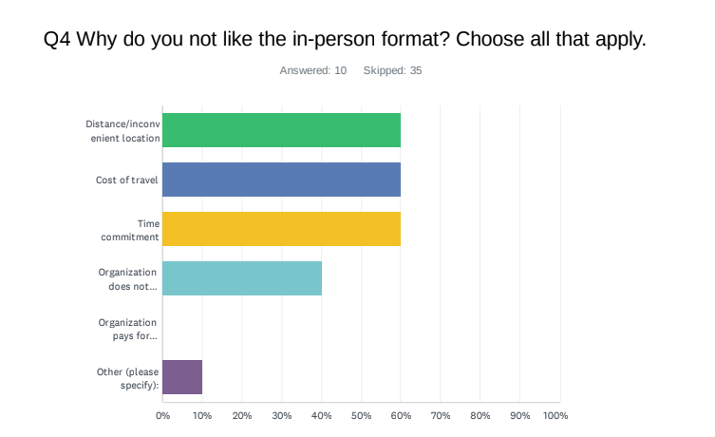
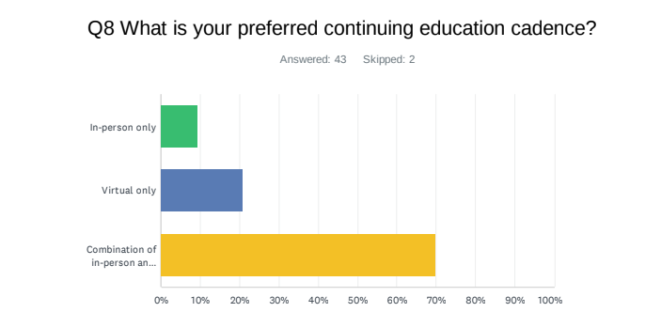
Survey Results
Overall themes:
Purpose of RTOW to be Continuing education
Like both In-Person and Virtual Options—CE was biggest reason
Miss networking when we only have virtual; also times not convenient for logging in
Distance, cost of travel, time deterrents to In-person attendance

Slide 19
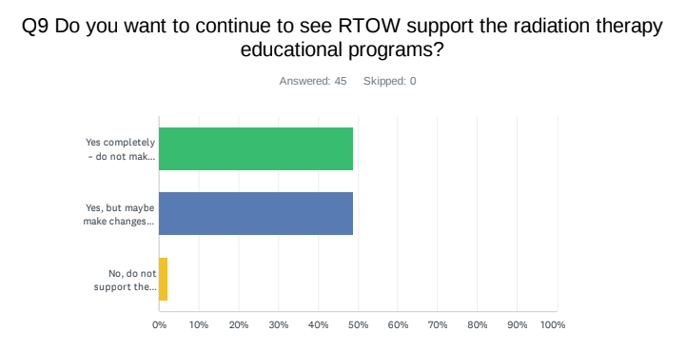
Education Program Support
Overall themes:
Yes to supporting Radiation Therapy Educational Programs
But split between keeping the mission and support type the same or changing

Slide 20
Survey Comments
Attract next generation of RTTs, more outreach with centers around WI.
Attract more interest in attending conferences. They are so valuable and rewarding. Networking in person is optimal.
Grow interest and support in the organization, the value of RTOW seems to be diminishing.
More transparency with the RTOW board, if having meetings, meeting notes, etc.
Meeting Locations—varied responses. Travel a big concern and everyone wants it close to home.

Slide 21
Next Steps
RTOW looking to have more member feed back on how we can accomplish the asks
Volunteers to form a Committee of members and board members to brainstorm
Increase networking and value of RTOW
Increase membership
Continue mission of supporting education programs
Board Transparency
Please reach out to Kim Keding or Miranda Scheppler if interested in helping with this

Slide 22
Thank you

